Slide 1

Burtrol: Strategic Partnership Proposal for Home Care Products
Burtrol, a subsidiary of Chilbur Chemicals Pvt Ltd, presents a partnership proposal for premium home care products. This presentation highlights the benefits of Burtrol's innovative, eco-friendly solutions and how they can benefit your company.
BY SALES MANAGER

Slide 2
Burtrol's Value Proposition: Enhancing Home Care
Competitive Edge
Operational Efficiency
Burtrol's products provide a distinct edge, offering premium solutions for wood care, clean energy, and effective cleaning.
Burtrol's products create exceptional healthy and hygienic environments for every household.

Slide 3
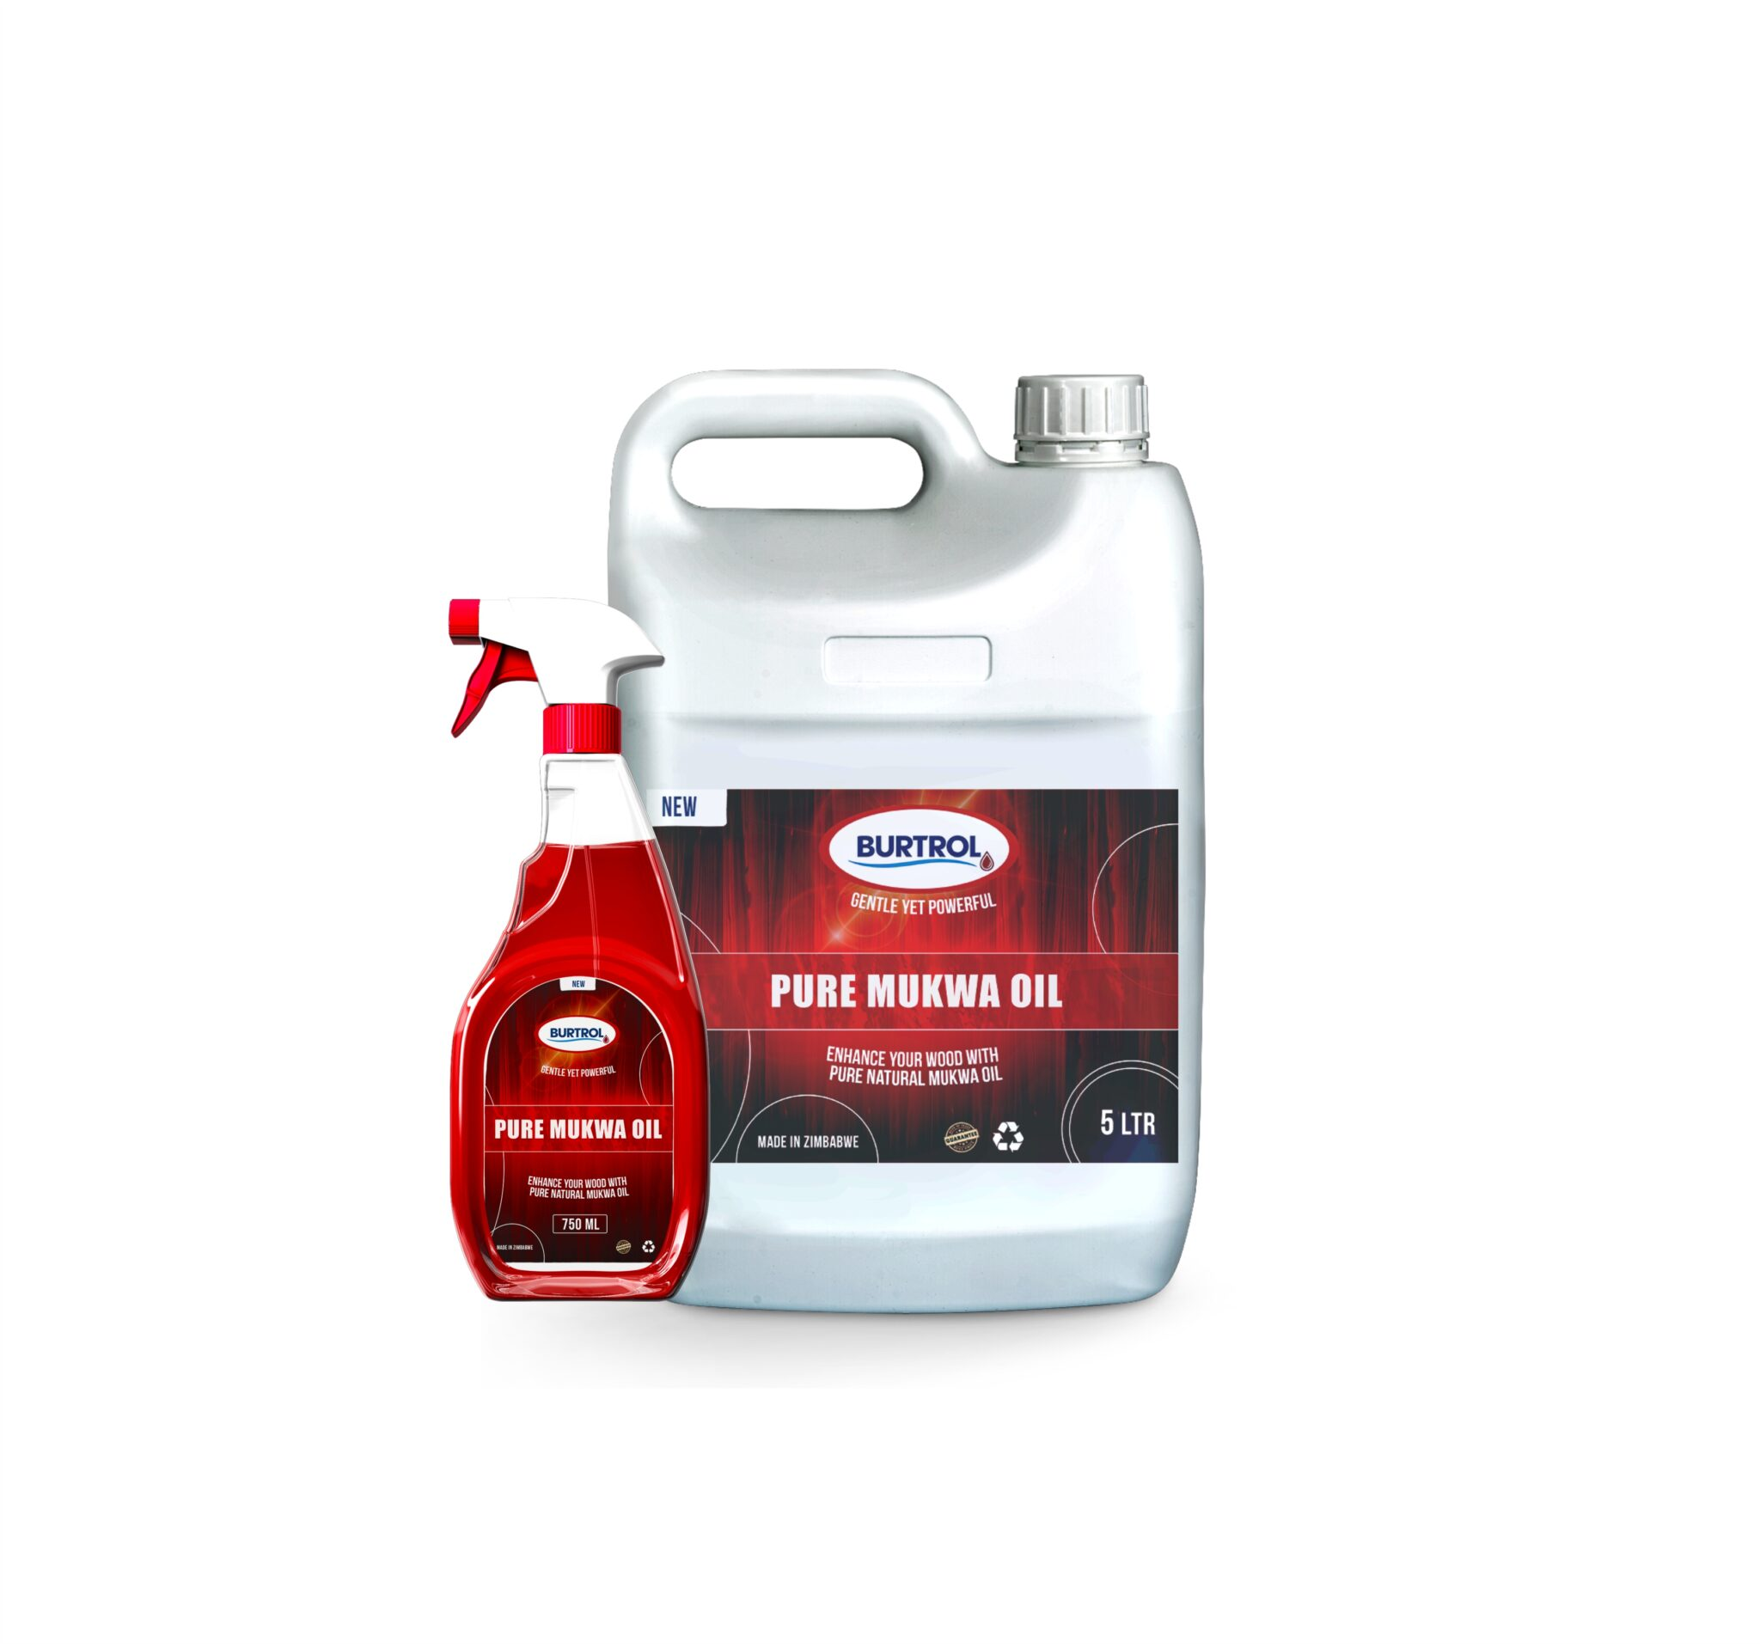
Pure Mukwa Oil: Nourishing Wood Care
Deep Nourishment
Long-Lasting Protection
Pure Mukwa Oil penetrates deep into wood, revitalizing and restoring its natural luster.
It forms a protective barrier, safeguarding wood from moisture, scratches, and everyday wear and tear.
Enhances Natural Beauty
Pure Mukwa Oil brings out the wood's natural grain, enhancing its beauty and richness.

Slide 4
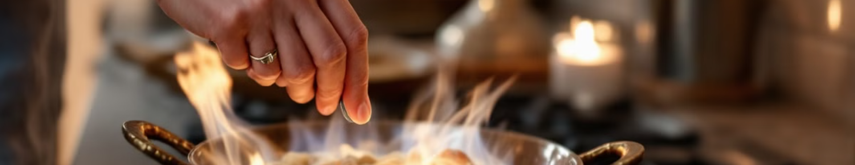



Heat Gel: Clean, Safe, and Efficient
Clean Combustion
Enhanced Safety
Convenience
Burns cleanly, emitting minimal smoke and soot, reducing indoor air pollution.
Less flammable than liquid fuels, making it safer to handle and store.
Ignites easily, provides consistent heat, making cooking faster and more efficient.

Slide 5
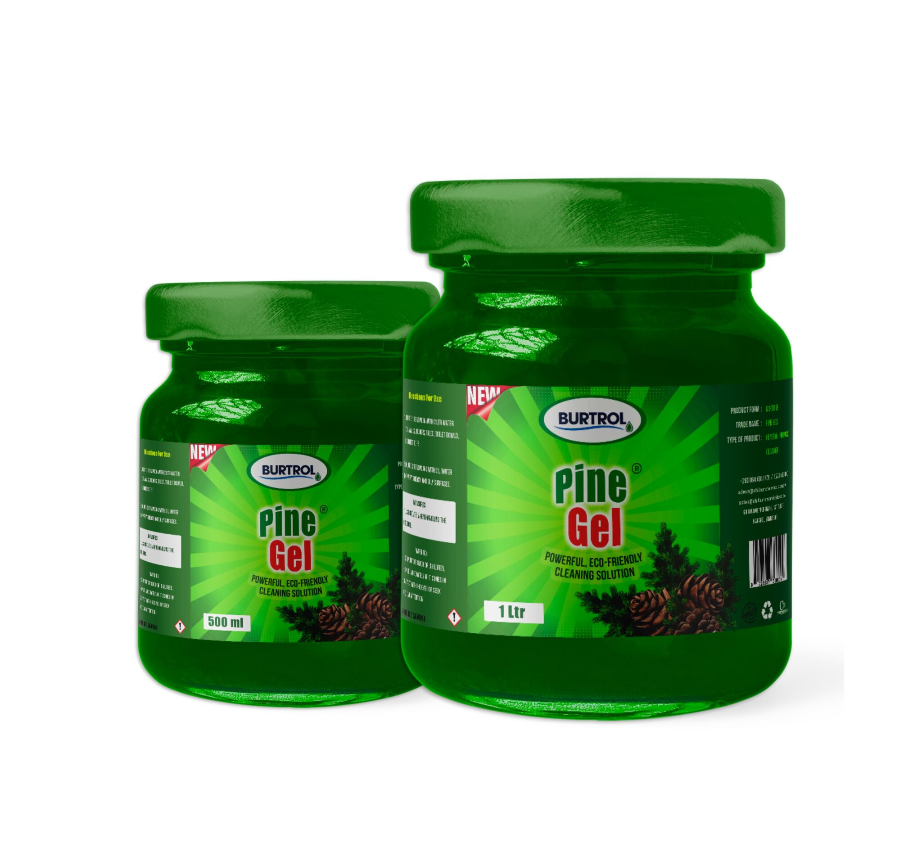
Pine Gel: Versatile and Eco-Friendly Cleaning
Multi-Surface Cleaner
Grease Cutting and Dirt Removal
Cleans effectively on tiles, countertops, walls, floors, and bathrooms.
Powerful formula tackles tough cleaning tasks, removing dirt and grime.
Antibacterial and Antifungal
Pine Gel effectively kills germs, promoting hygienic conditions in households and industries.

Slide 6
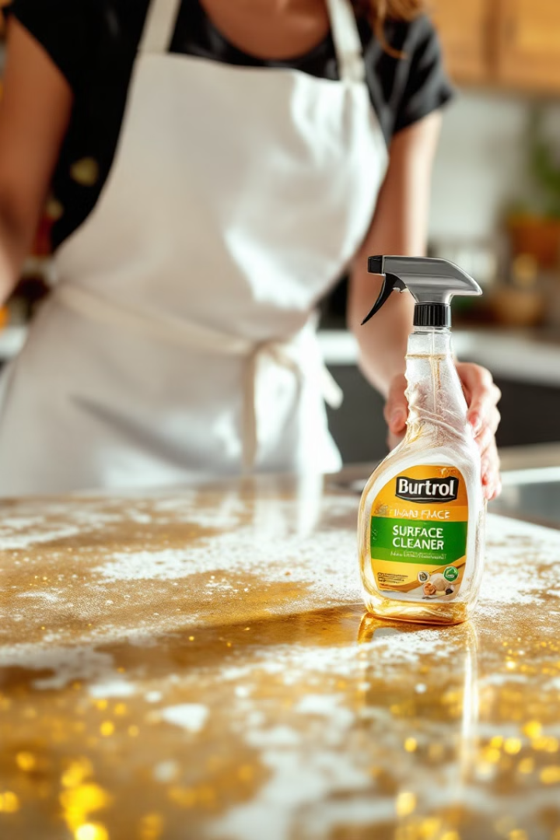
Hard Surface Cleaner: A Revolution in Cleaning
1
Powerful Formula
Cleans even the toughest surfaces, removing dirt, grime, and stubborn stains.
2
Superior Stain Removal
Effectively eliminates coffee, wine, and grease stains, leaving surfaces spotless.
3
Environmentally Friendly
Biodegradable formula is safe for all surfaces and environmentally responsible.

Slide 7




The Power of Partnership: Shared Success
1
Enhanced Brand Reputation
2
Reduced Costs
3
Improved Product Quality
4
Increased Sales & Market Share

Slide 8

Next Steps: Building a Strong Future Together
We invite you to schedule a meeting to explore this exciting opportunity further. Together, we can unlock the potential of this partnership and bring Burtrol's exceptional home care products to a wider audience.

